Slide 1
Human Resources Data Set and Employee Termination Prediction
By: Khaled Mohamed Abdelnaby
Data scientist

Slide 2
Agenda
Introduction
Problem Statement and Business
Objectives Data problems and cleaning
Dataset
Exploratory Data Analysis
Modelling and Accuracy
Improvements

Slide 3
Introduction
HR data can be hard to come by, and HR professionals generally lag with respect to analytics and data visualization competency.
Thus, Dr. Carla Patalano set out to create HR-related dataset, which is used in one of graduate courses called HR Metrics and Analytics.
Dr. Carla Patalano provided the baseline idea for creating this synthetic data set, which has been used now by over 200 Human Resource Management students at the college.

Slide 4
Problem Statement and Business
We've included some open-ended questions that we can explore and try to address through creating Tableau visualizations, or R or Python analyses.
Is there any relationship between who a person works for and their performance score?
What is the overall diversity profile of the organization?
What are our best recruiting sources if we want to ensure a diverse organization?
Can we predict who is going to terminate and who isn't? What level of accuracy can we achieve on this?
Are there areas of the company where pay is not equitable?

Slide 5
Objectives Data problems and cleaning
Analysis a variety of features that are useful for both data visualization and creating machine learning / predictive analytics models
Maximize HR’s return on investments and make the business case for HR’s objectives.
Quantify the value of HR dataset

Slide 6
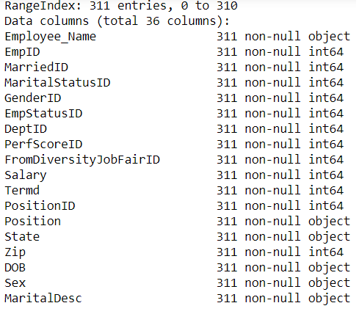
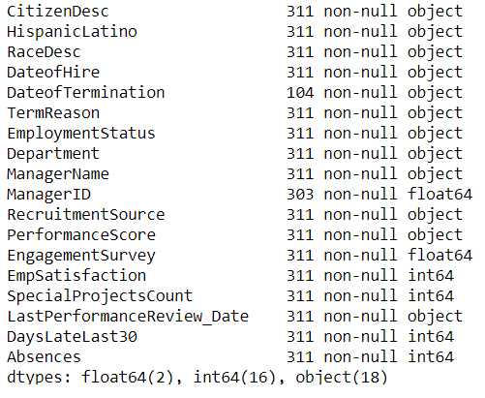
Dataset
HR dataset down to a single data file (v14). The CSV revolves around a fictitious company and the core data set contains names, DOBs, age, gender, marital status, date of hire, reasons for termination, department, whether they are active or terminated, position title, pay rate, manager name, and performance score.

Slide 7
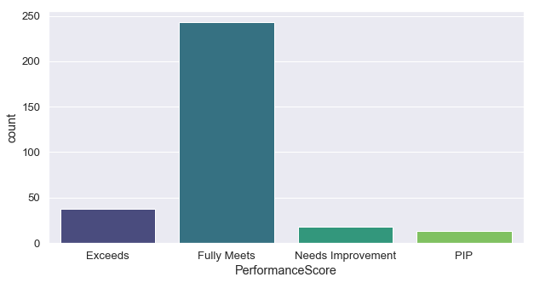
Exploratory Data Analysis Performance Score
How is Performance Score distributed in the dataset ?

Slide 8
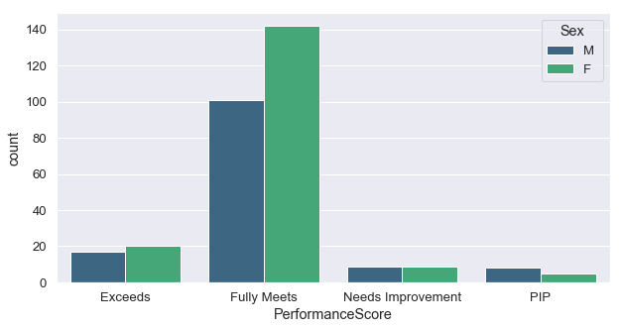
Exploratory Data Analysis Performance Score
How is Performance Score distributed in the dataset ?

Slide 9
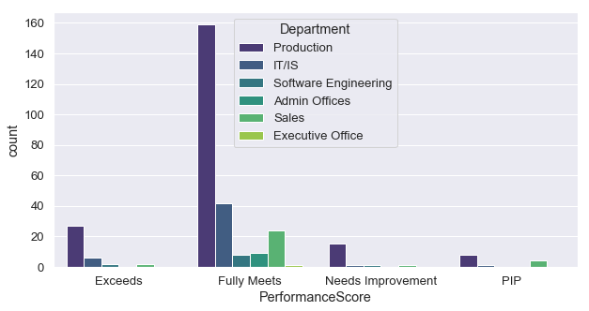
Exploratory Data Analysis
Performance Score distributed in different Department

Slide 10
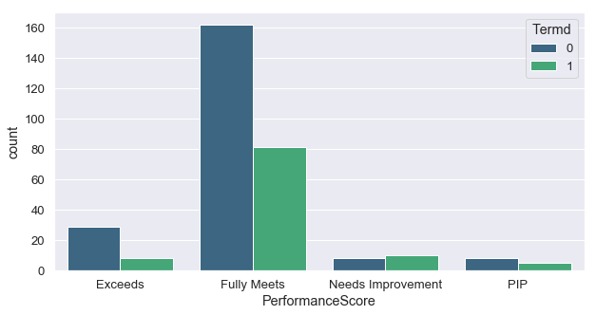
Exploratory Data Analysis
Performance Score distributed in different Department

Slide 11
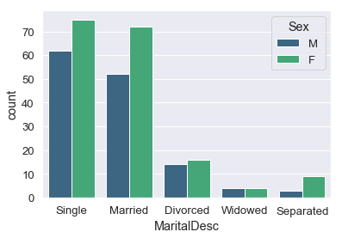
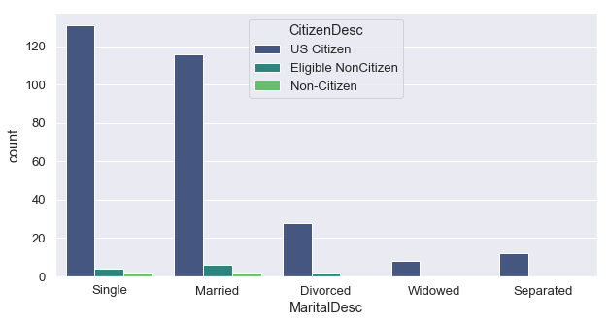
Exploratory Data Analysis Marital Description
Distribution of Marital Description with gender type
Distribution of Marital Description with Citizen Description

Slide 12
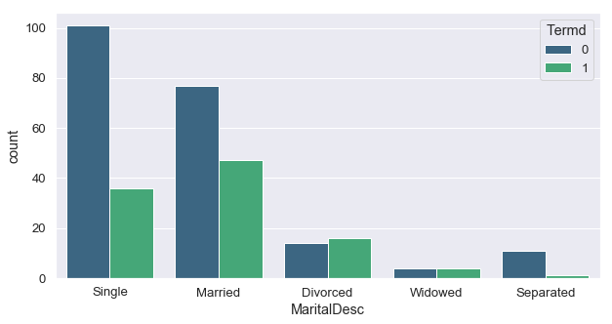
Exploratory Data Analysis Marital Description
Distribution of Marital Description which termed or not

Slide 13
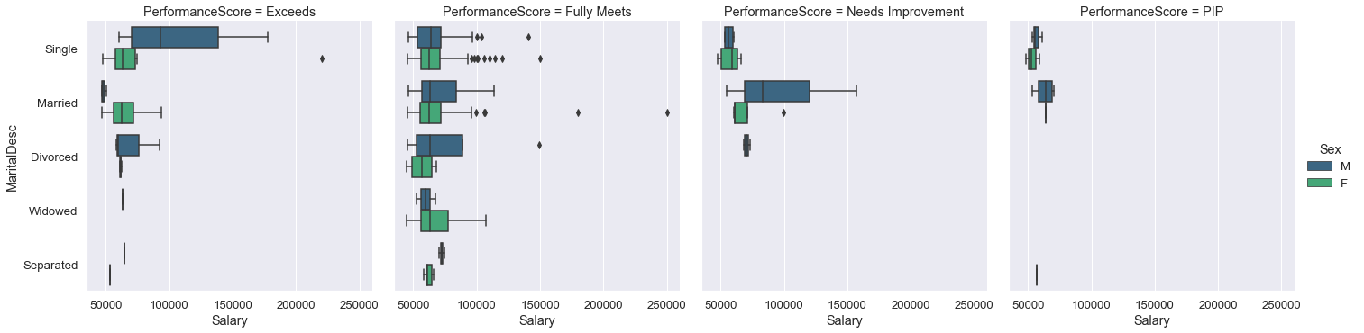
Exploratory Data Analysis Marital Description

Slide 14
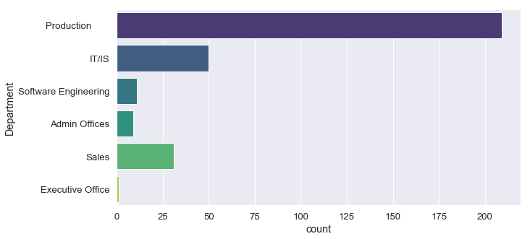
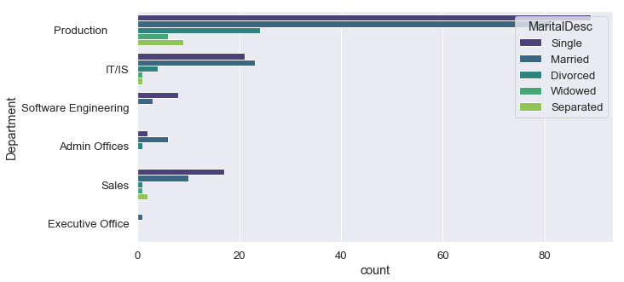
Exploratory Data Analysis Department
The sales department needs to be watched since it's the department which requires the most performance improvement plan (PIP). These have been set to address failures to meet specific job goals or to ameliorate behavior-related concerns.

Slide 15
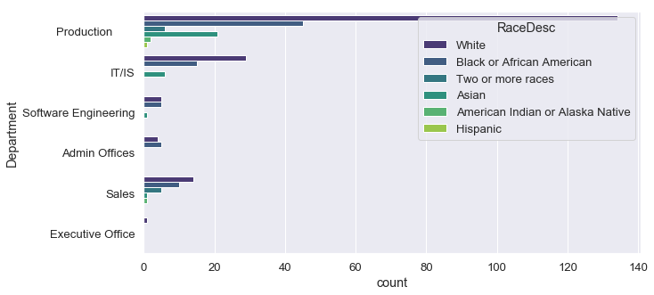
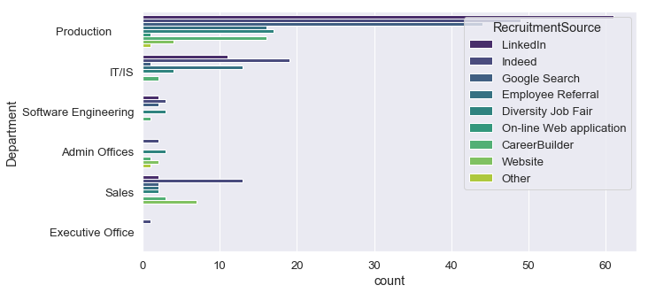
Exploratory Data Analysis Department
Distribution of Races and Recruitment Source in different Department

Slide 16
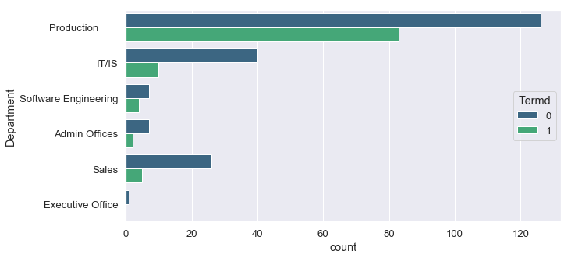
Exploratory Data Analysis Department
Distribution of Department count with termination

Slide 17
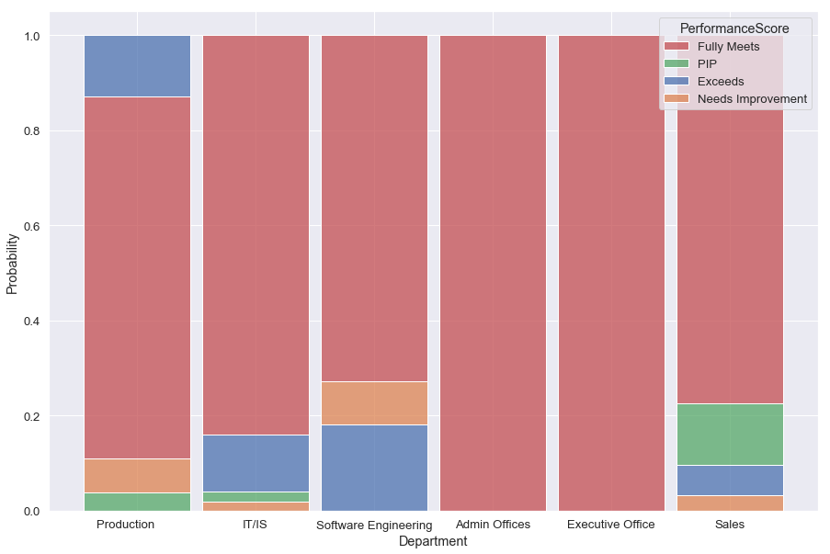
Exploratory Data Analysis
The histogram allows us to see the conditional probability of Department given Performance Score. It's a way to grasp the overall performance of the company but knowing the fact the production department is much bigger than other departments, we can do better taking the performance score given the department.

Slide 18
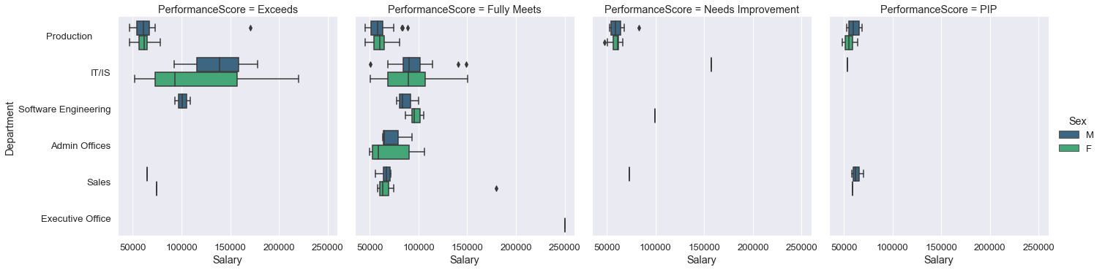
Exploratory Data Analysis
It's also interesting to see the distribution of salaries between individuals having different performance scores and different Department supervising them :

Slide 19
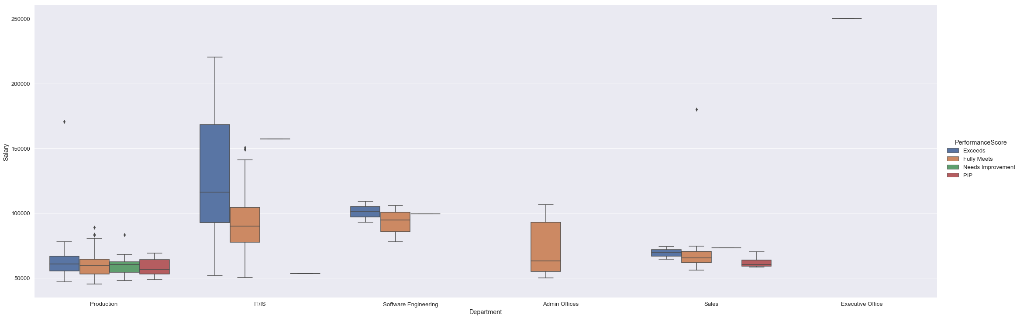
Exploratory Data Analysis
It's also interesting to see the distribution of salaries between individuals having different performance scores and different Department supervising them :

Slide 20
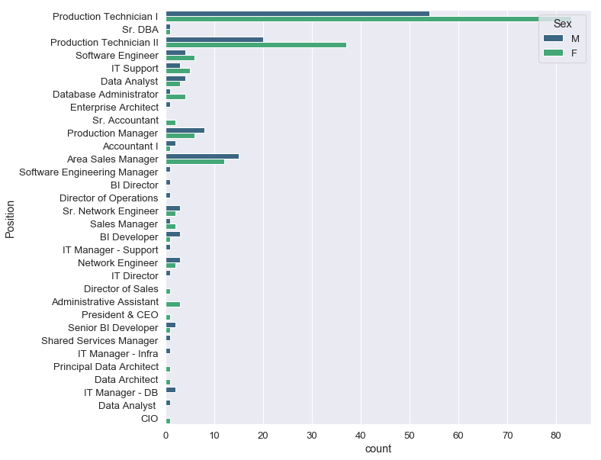
Exploratory Data Analysis Position Data
Count Distribution in different positions with Gender

Slide 21
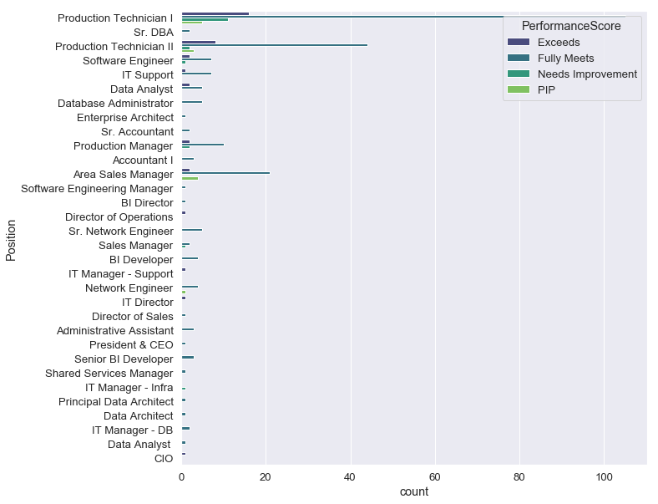
Exploratory Data Analysis
The Performance Score Distribution in different positions

Slide 22
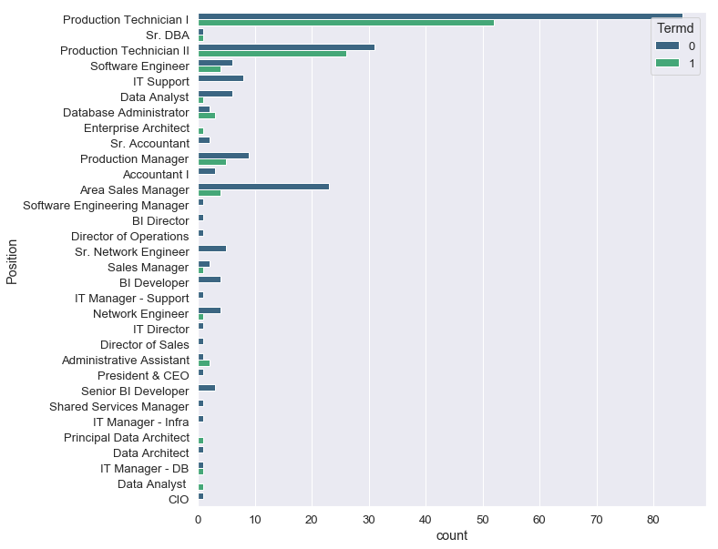
Exploratory Data Analysis
This fig show count of each position which termed or not

Slide 23
Exploratory Data Analysis Managers
How many managers are there in the company ?
21 unique managers are currently working in the company :
['Michael Albert' 'Simon Roup' 'Kissy Sullivan' 'Elijiah Gray’ 'Webster Butler' 'Amy Dunn' 'Alex Sweetwater' 'Ketsia Liebig’ 'Brannon Miller' 'Peter Monroe' 'David Stanley' 'Kelley Spirea’
'Brandon R. LeBlanc' 'Janet King' 'John Smith' 'Jennifer Zamora’ ‘Lynn Daneault' 'Eric Dougall' 'Debra Houlihan' 'Brian Champaigne’ 'Board of Directors']

Slide 24
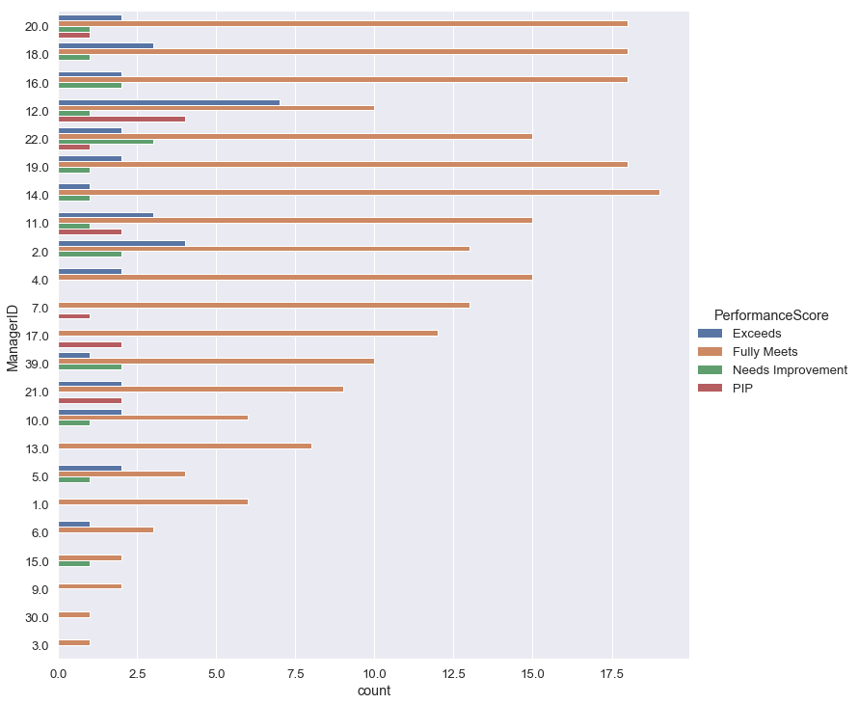
Exploratory Data Analysis
Which managers supervise the most in the company ?

Slide 25
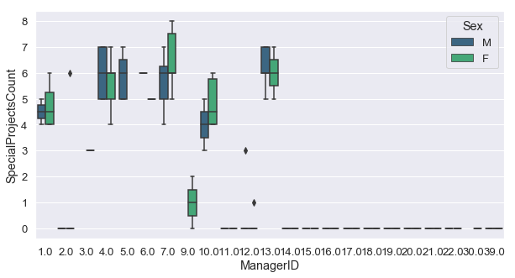
Exploratory Data Analysis
This fig show of Special project count for all manager which gender data

Slide 26
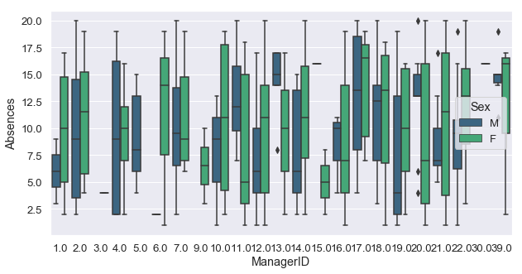
Exploratory Data Analysis
This fig show Absence for all manager which gender data

Slide 27
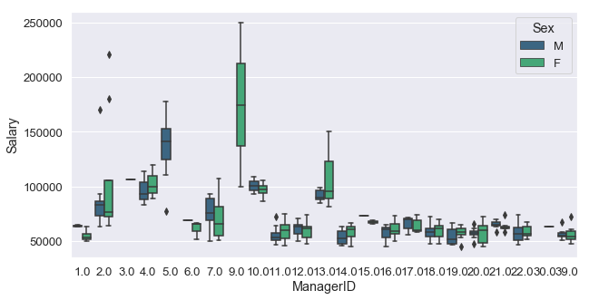
Exploratory Data Analysis
This fig show salary for Managers with Gender

Slide 28
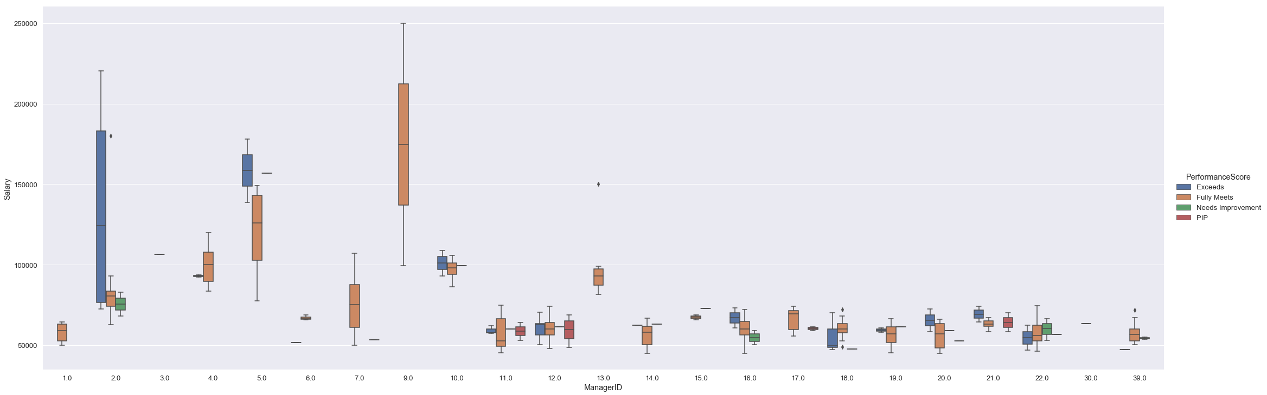
Exploratory Data Analysis
It's also interesting to see the distribution of salaries between individuals having different performance scores and different managers supervising them :

Slide 29
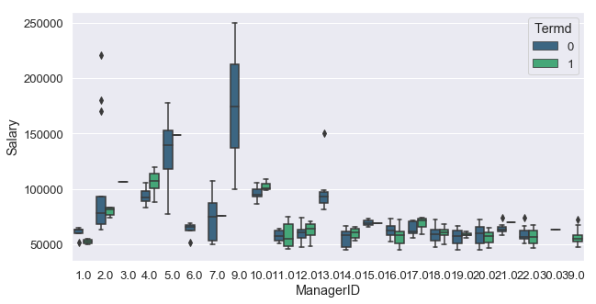
Exploratory Data Analysis
This fig present the 3 factor for Manager (Manager_ID, his Salary and his Status )

Slide 30
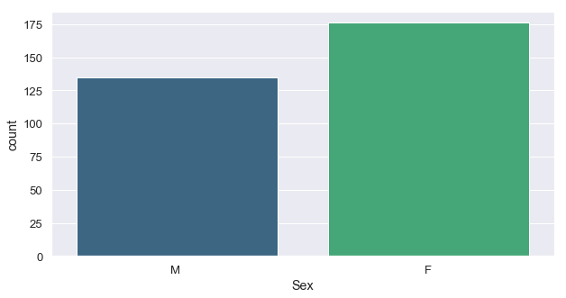
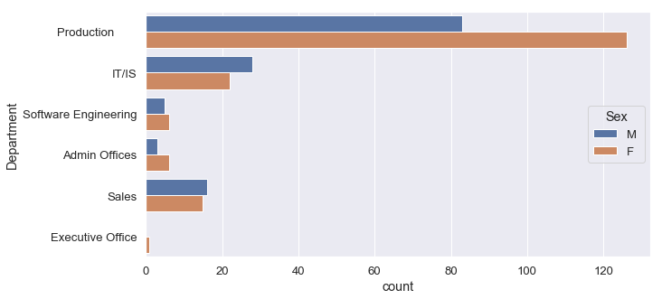
Exploratory Data Analysis
What is the overall diversity profile of the organization ?

Slide 31
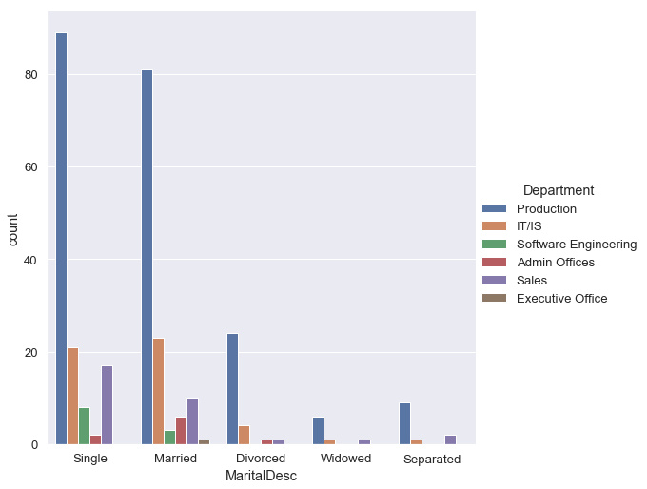
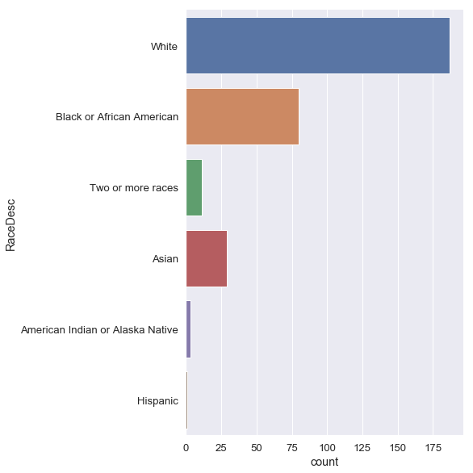
Exploratory Data Analysis

Slide 32
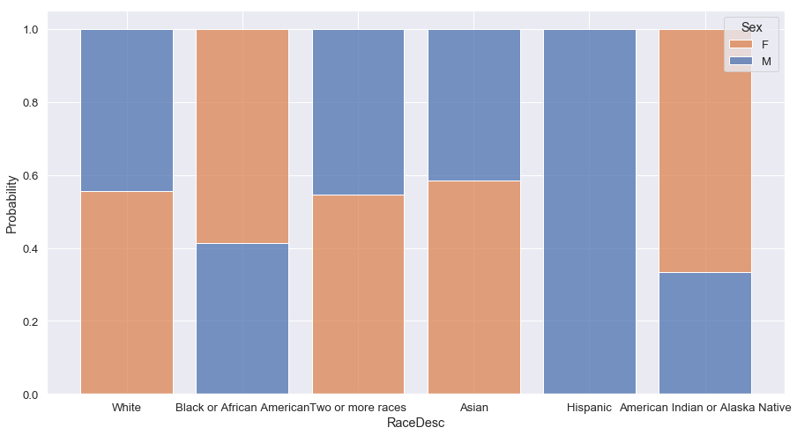
Exploratory Data Analysis
The histogram allows us to see the conditional probability of Races given sex data.

Slide 33
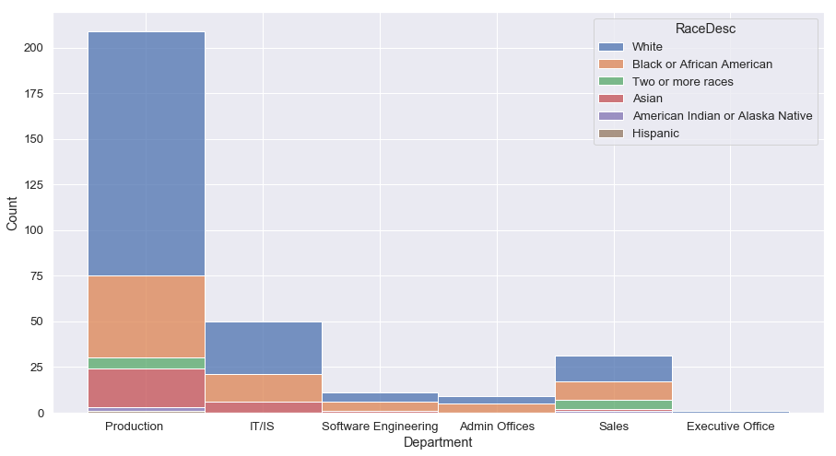
Exploratory Data Analysis
The histogram allows us to see the conditional probability of Department Races data.

Slide 34
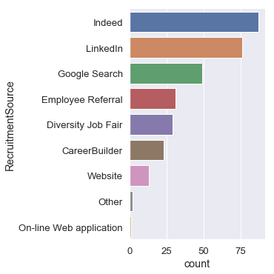
Exploratory Data Analysis
What are our best recruiting sources if we want to ensure a diverse organization ?

Slide 35
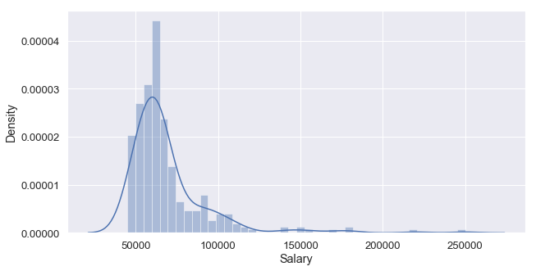
Exploratory Data Analysis distribution of salaries in the company
Are there areas of the company where pay is not equitable ?

Slide 36
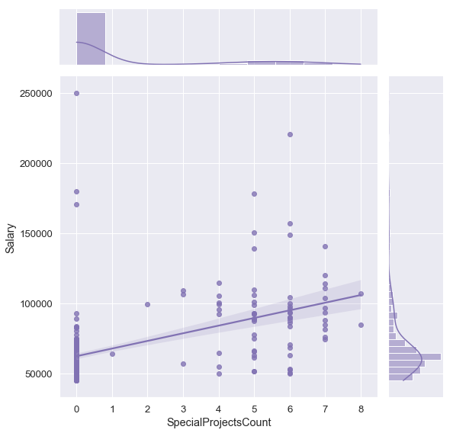
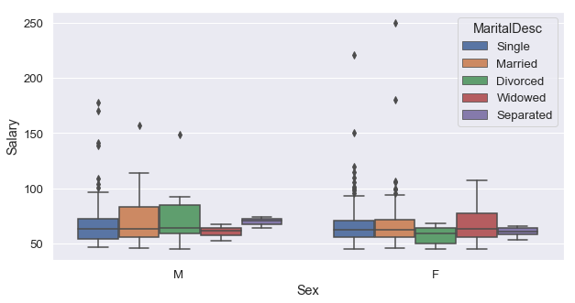
Exploratory Data Analysis

Slide 37
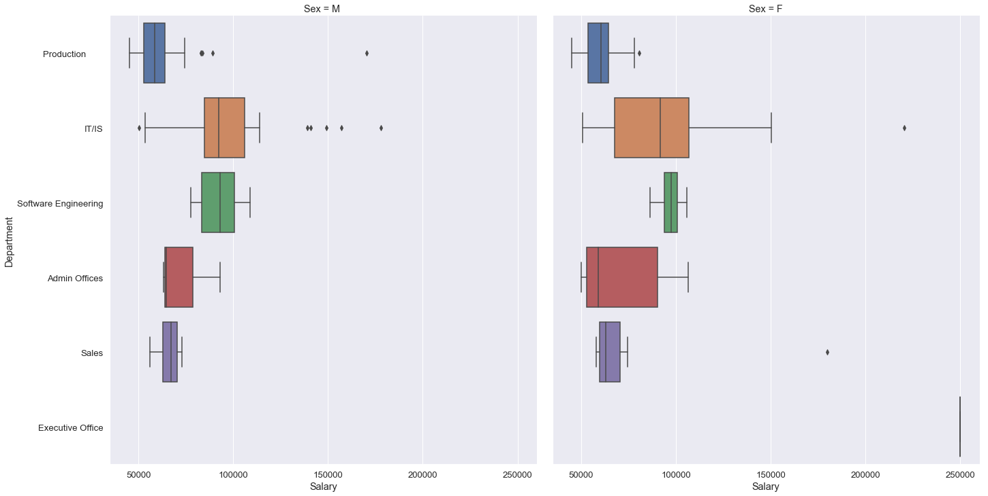
Exploratory Data Analysis
distribution of salaries in the company

Slide 38
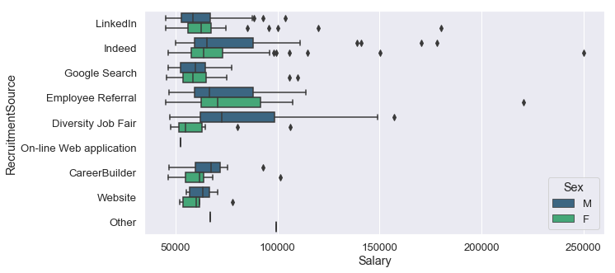
Exploratory Data Analysis
distribution of salaries in the company

Slide 39
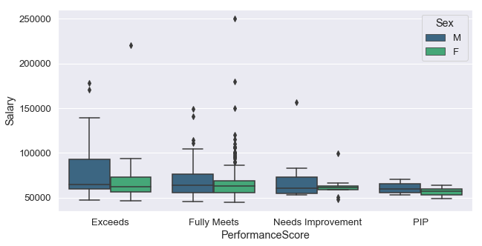
Exploratory Data Analysis
distribution of salaries in the company

Slide 40
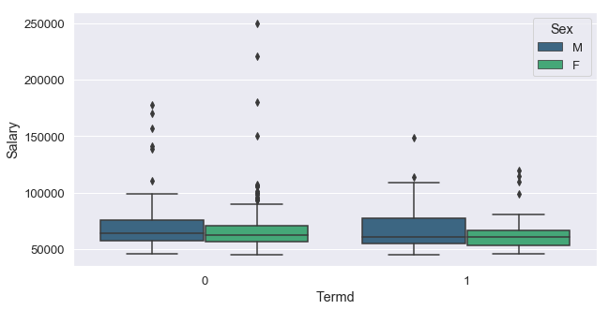
Exploratory Data Analysis
distribution of salaries in the company

Slide 41
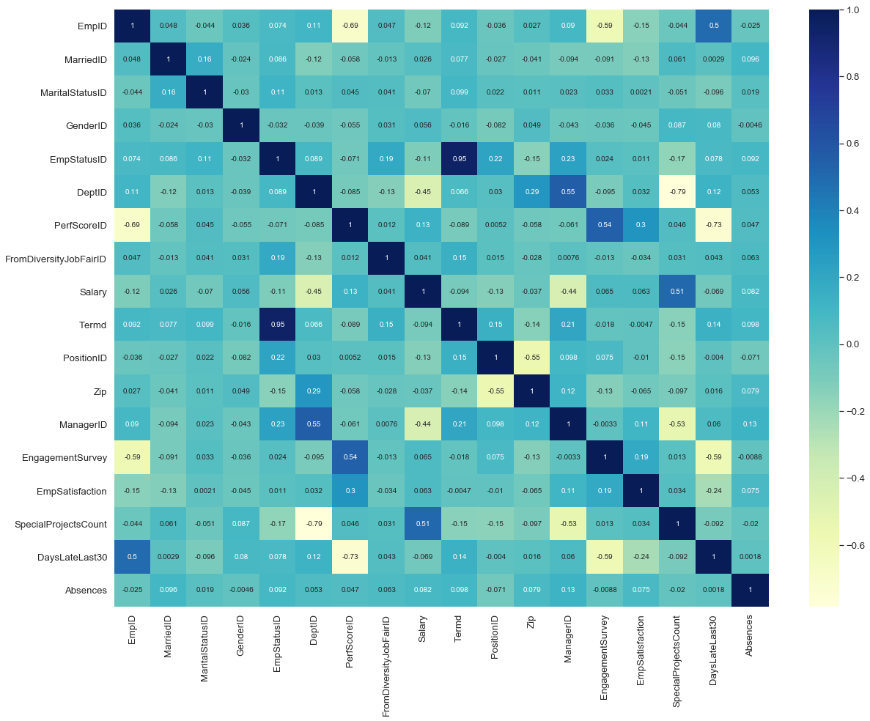
Feature Selection

Slide 42
Machine learning Model
K-Nearest Neighbors
Logistic Regression
Support Vector Machine
Decision Tree"
Neural Network"
Random Forest
XGB Classifier

Slide 43
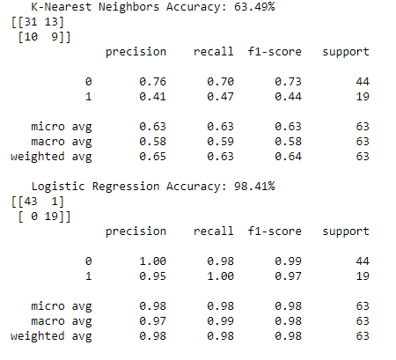
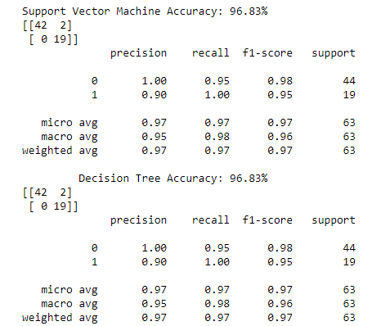

Slide 44
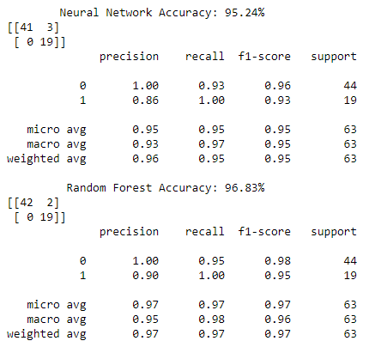
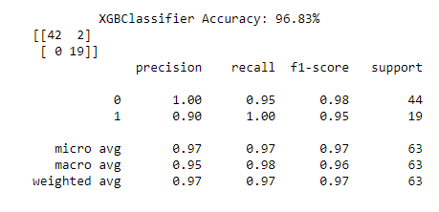

Slide 45
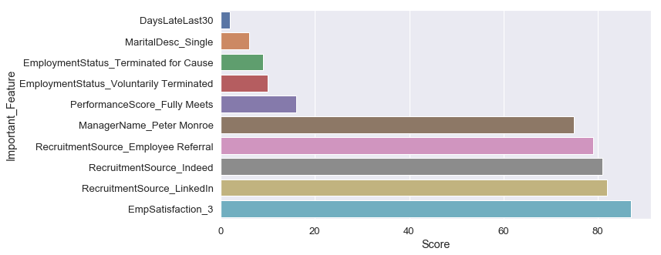
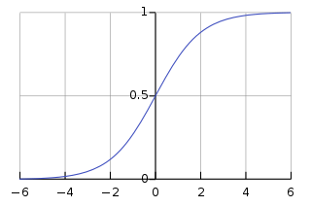
Visualize important feature
Logistic Regression
Logistic Regression did a great work and achieve better accuracy .

Slide 46
Improvements
Deeper dive into data analysis and cleaning (wasn’t done due to the time limitation)
Logistic Regression did a great work and achieve better accuracy .

